Slide 1
HR Data Analysis
Vaishali Burange

Slide 2
Introduction:
Employee attrition, the phenomenon of employees leaving the company, poses significant challenges for organizations in terms of productivity, morale, and financial costs. In this project, we aim to uncover the factors that contribute to employee attrition and develop predictive models to identify employees at risk of leaving.
Objective:
The primary objective of this analysis is to understand the factors associated with employee attrition and provide actionable insights to mitigate attrition rates. Additionally, we seek to build predictive models to forecast attrition risk and assist in proactive retention strategies.

Slide 3
Content of data:
Age: The age of the employee.
Attrition: Whether the employee has left the company.
BusinessTravel: Frequency of business travel.
DailyRate: The daily rate of pay for the employee.
Department: The department the employee belongs to.
DistanceFromHome: Distance from home to work location.
Education: Level of education.
EducationField: Field of education.
EmployeeCount: Number of employees.
EmployeeNumber: Unique identifier for each employee
EnvironmentSatisfaction: Level of satisfaction with the work environment.
Gender: Gender of the employee.
HourlyRate: The hourly rate of pay for the employee.
JobInvolvement: Level of involvement in the job.
JobLevel: Level of the job within the company hierarchy.
JobRole: Role of the employee within the company.
JobSatisfaction: Level of satisfaction with the job.
MaritalStatus: Marital status of the employee.
MonthlyIncome: Monthly income of the employee.
MonthlyRate: Monthly rate of pay for the employee.
NumCompaniesWorked: Number of companies the employee has worked for previously.

Slide 4
Over18: Whether the employee is over 18 years old.
OverTime: Whether the employee works overtime.
PercentSalaryHike: Percentage increase in salary.
PerformanceRating: Performance rating of the employee.
RelationshipSatisfaction: Level of satisfaction with work relationships.
StandardHours: Standard number of working hours per week.
StockOptionLevel: Level of stock options the employee has.
TotalWorkingYears: Total number of years the employee has worked.
TrainingTimesLastYear: Number of training sessions attended by the employee last year.
WorkLifeBalance: Level of work-life balance satisfaction.
YearsAtCompany: Number of years the employee has worked at the company.
YearsInCurrentRole: Number of years the employee has been in the current role.
YearsSinceLastPromotion: Number of years since the employee's last promotion.
YearsWithCurrManager: Number of years the employee has worked with the current manager.

Slide 5
Target column ==Attrition
Attrition: attrition is the departure of employees from the organization for any reason or in simple words we can say that employees who want to leave the company.
Attrition "YES" ": Employee wants to leave the company.
Attrition "NO" ": Employee want don't to leave the company.
in this project we are going to analyse that how other features of dataset is effecting "Attrition"

Slide 6
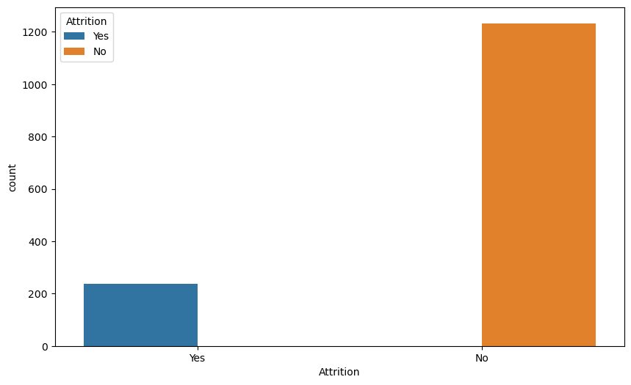
EDA(Exploratory Data Analysis)
Analysis on catagorical columns with respect to target column(Attrition)
Data of Attrition says that it has more number of "NO" values and less number of "Yes“ values
it can seen that there is big difference in counts of the values

Slide 7
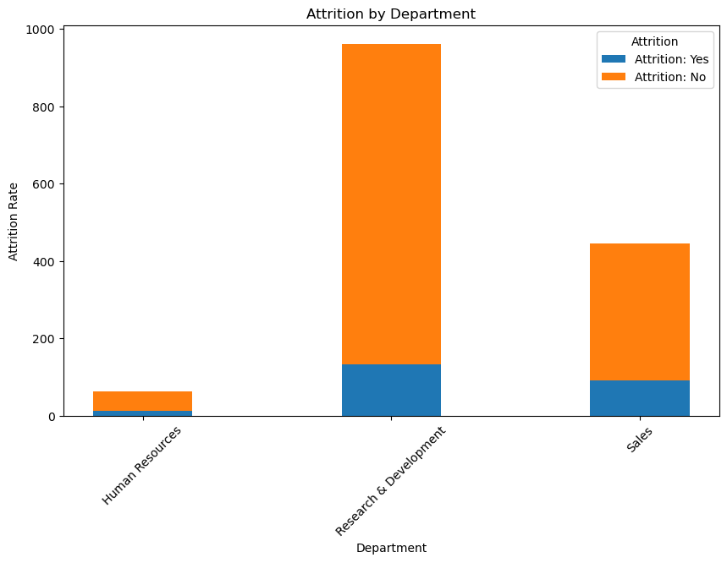
2)How does attrition vary by department?
there are 3 no.of department are there 1)sales 2) Research and development 3)HR department
"research and development" department have more number of attrition as compared to other two department,research and development in there more number of employees, this department affecting the most for attrition
"Human Resource" Department have least attrition

Slide 8
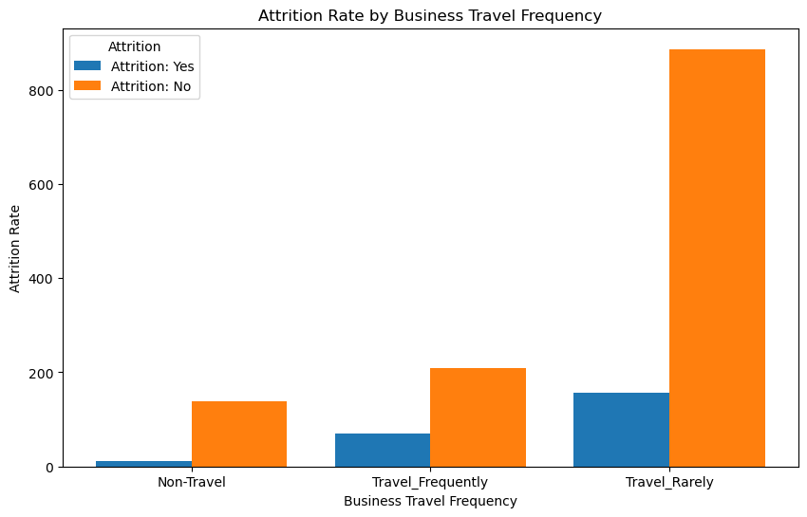
3)Attrition Rate by Business Travel Frequency
graph tells us that company has more count or more number of employees who travels rarely.it means travel rate of company is less
there are more employees which travels rarely and are not satisfied with their job
non traveller have least count as well as least attrition

Slide 9
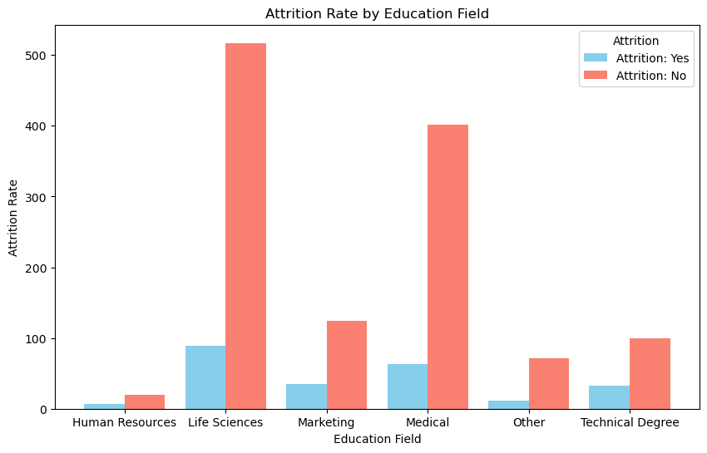
4)Attrition Rate by Education Field
first and foremost thing is that employees who are from "life science" and "medical"background are more as compared to other education fields
life science and medical these two are the more affecting

Slide 10
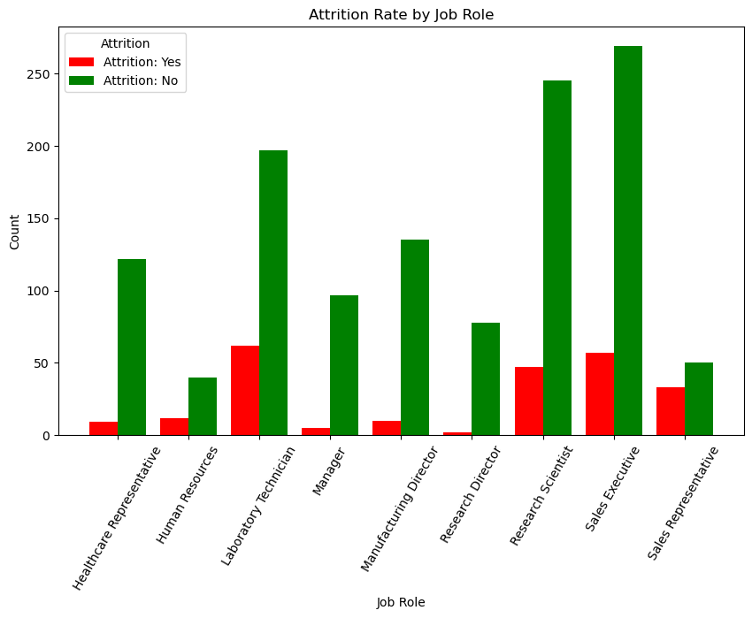
5)Attrition Rate by Job Role
in this graph which job role is affecting much attrition
there are less no of Research director who leaves the company Laboratory Technician,Sales Executive,Research Scientist these are the top 3 roles which employees have this attrition "yes”
in this graph it can also seen that there are more number of employees in Sales Executive job role.

Slide 11
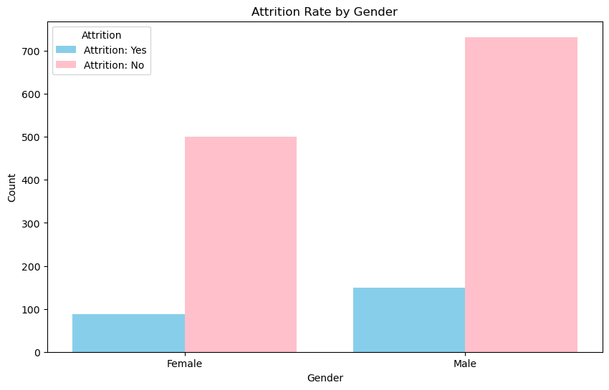
6)Attrition Rate by Gender
more number of employees are male employee as compare to females
males are more likely to quit the job rather than female.

Slide 12
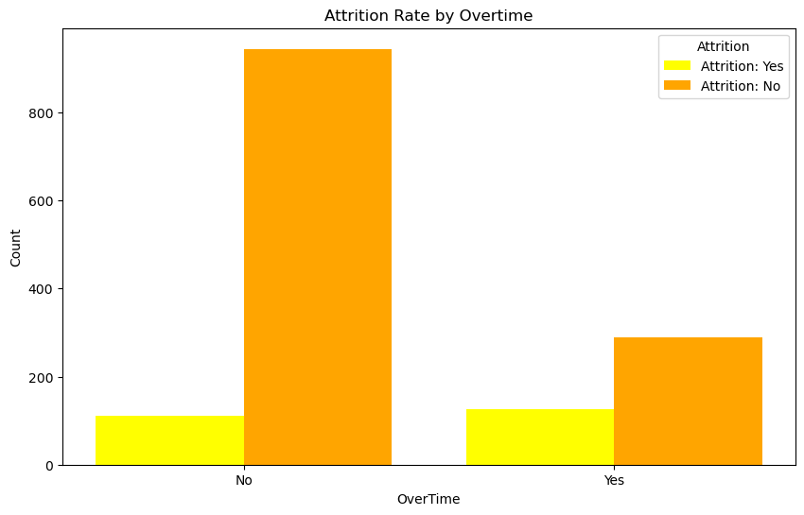
7)Are employees who work overtime more likely to leave the company?
"yes" means employees who are doing over time "no" means who are not doing overtime
overtime is not affecting the attrition
but we can conclude that most of the employee are not doing overtime.

Slide 13
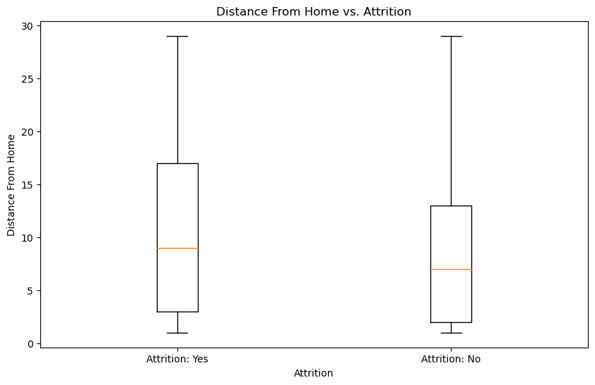
8)Calculate mean distance from home for employees who left and stayed
Mean distance from home for employees who left the company (Attrition: Yes): 10.632911392405063
Mean distance from home for employees who stayed in the company (Attrition: No): 8.915652879156529
9)distance from home and attrition
employees who has distance range of 0-10 km ,are more likely to leave the job
we can also conclude that lesser the distance more number of employees are working

Slide 14
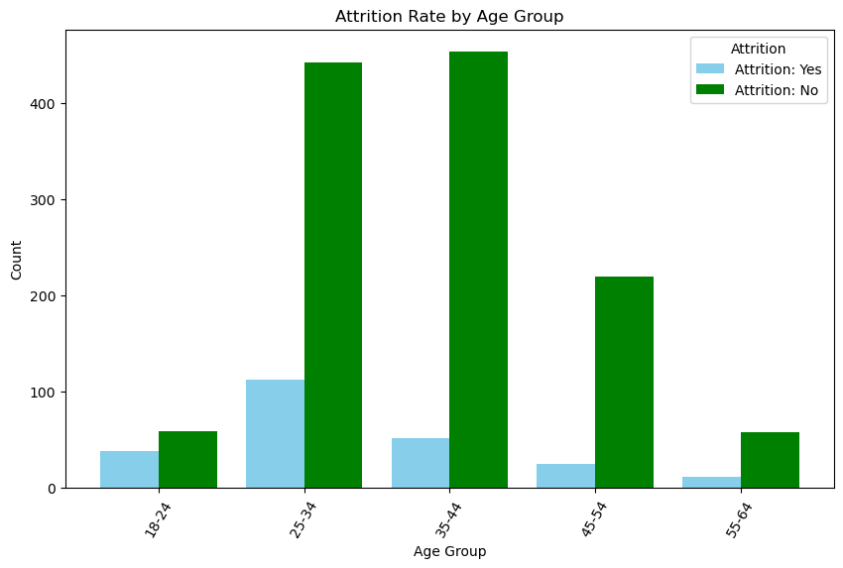
10)Attrition Rate by Age Group
employees in age of 25 to 34 are more likely to leave the job

Slide 15
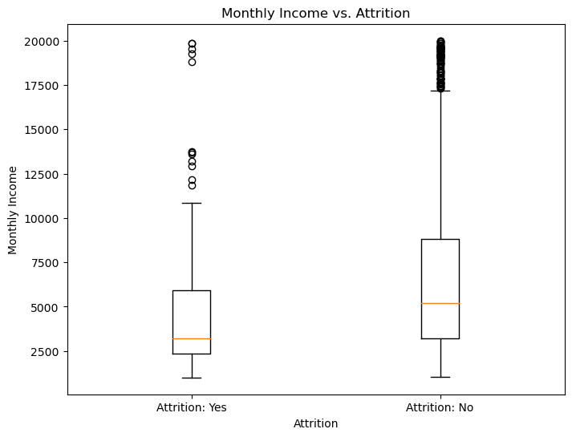
11)Monthly Income vs. Attrition
higher the monthly income give rise to less attrition (means attrition="no")
employees who have their income approx 2500 are more likely to quit job because 2500 is the least range of income

Slide 16
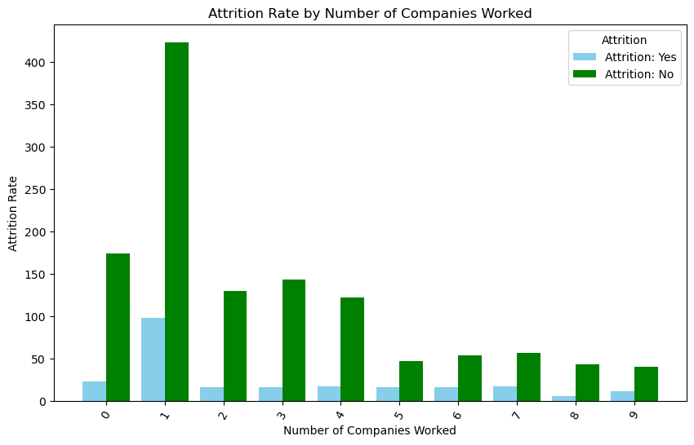
12)Calculate attrition rate for each number of companies worked
only that employees (no.of emp=100) who worked with 1 company before have most attrition.(attrition "yes").rest have similar data

Slide 17
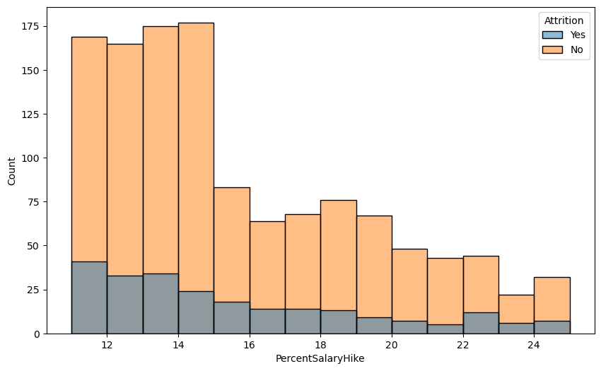
13)how salary hike is impacting the attrition
higher the salary hike .lesser the attrition("NO")

Slide 18
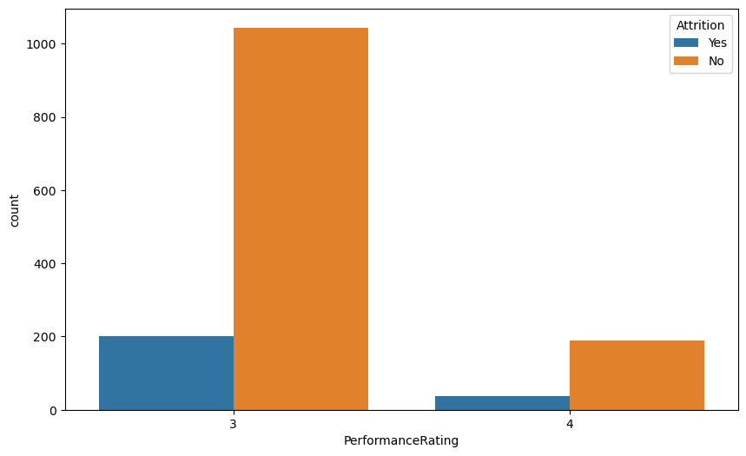
14) Performance rating And Attrition
on an average, most of employees are moderately performance rating lies in (3-4)
however employees having less performance rating are more likely to quit or we can say that company wants to fire that employees.

Slide 19
THANK YOU

